Slide 1

Web Development: An overview of technologies, best practices, and vendor options for building Web Applications
Deloitte Consulting LLP

Slide 2
Today’s Discussion
Objectives
Agenda
By the end of this session you will be able to:
Provide an overview of Web Development and Web Applications
Describe the technology components necessary for Web Development
Apply Web Development best practices, design patterns, and frameworks
Describe different Web Development Methodologies
Compare and contrast Web Development “Stacks”
Web Development Overview
Technologies
Practices, Principles, and Frameworks
Web Development Methodologies
Vendor Choices
Notes:
This course will be particularly helpful if you have little or no web development experience.
High level knowledge of web development and web applications will give familiarity into how many of our clients conduct their business. Since so much of the business in this day and age is carried out online, Deloitte practitioners should have an understanding of how our clients rely on web-based services/applications to accomplish their work.
By understanding the technology, best practices, development methodologies, participants will understand what is needed to pick up at any point in the Web Development SDLC for any given client.
Vendor choices will give participants insight into the best vendor options for Web Development – helping them to direct their future learning efforts and skills to assist clients in their project.

Slide 3
Agenda – Web Development Overview
Web Development Overview
Technologies
Practices, Principles, and Frameworks
Web Development Methodologies
Vendor Choices

Slide 4
Agenda – Practices, Principles, and Frameworks
Web Development Overview
Technologies
Interacting with a Database
Databases, Security and SQL Injection

Slide 5
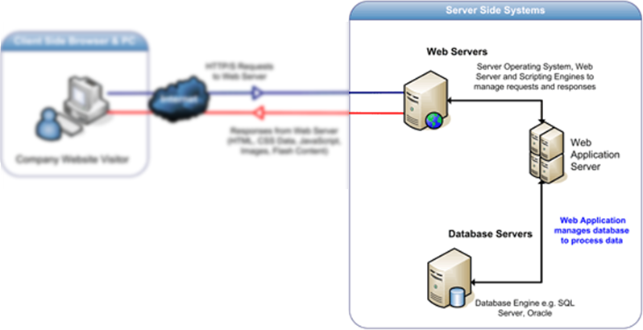
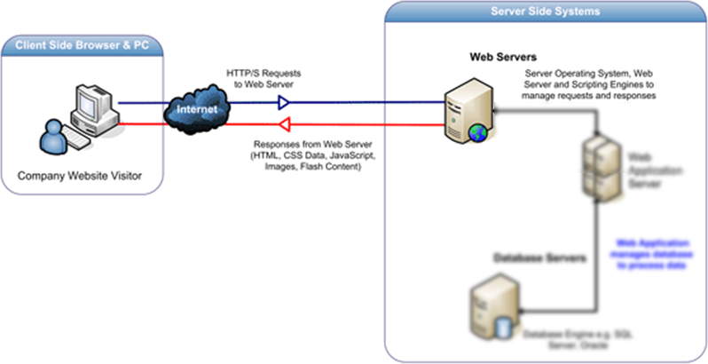
Interacting with a database
We’ve just looked a lot at how the front-end of a web application is developed. You got to play with HTML, CSS and JavaScript to control how the web pages appeared to your users.
Front-End
Back-End
Now let’s look at how we build out the back-end. At it’s simplest level, this requires a database and some simple scripting language to interact with that database.

Slide 6
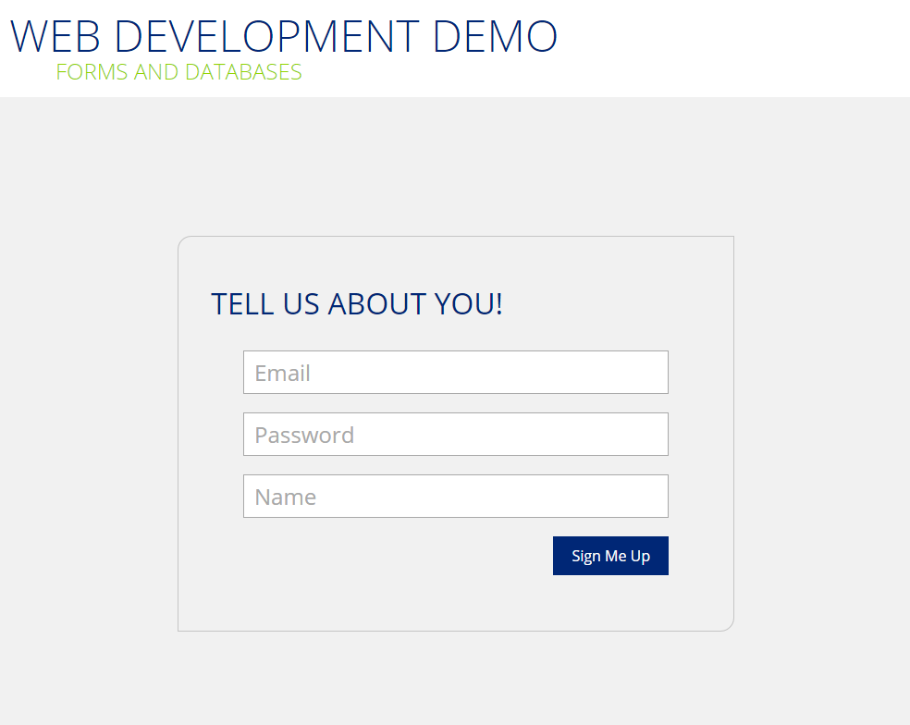
What a form looks like on a page

Slide 7
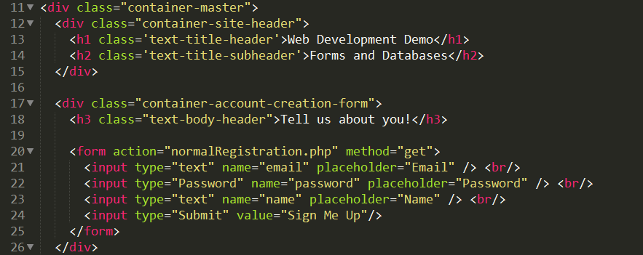
Let’s look at the code – starting with the HTML
Important elements included in this HTML
The “DIV” element might be new. It acts as a container we use to group elements that logically go together. Here we group the form header and the form elements themselves. We can then easily use CSS to arrange the different containers on the page.
The Form element is also likely new.
Can you guess what the placeholder attribute does?
What are the different types of inputs? What do you think the difference is for each?
What basic steps do you think need to happen to store this data?

Slide 8
A conceptual flow chart of how we get the data into the database
Client Side
Server Side
Data is collected through a form on an HTML page
Data is submitted to the target page
Script on target page loads the submitted data
Script prepares necessary SQL statements
Script connects to the database and passes the SQL statement
Database processes the request and confirms results
User sees the result page
Web server sends the parsed page back to browser
Script continues rendering the rest of the page
Notes:
Talk about cloud?

Slide 9
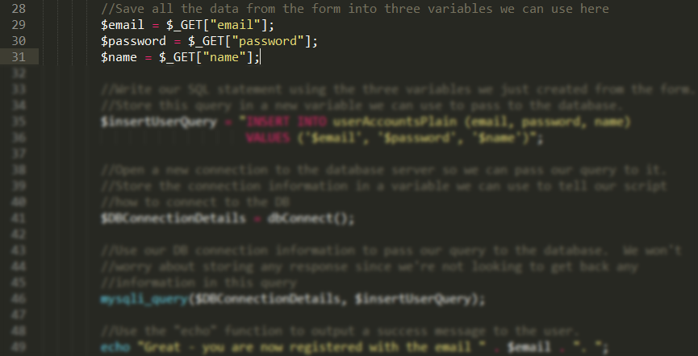
The code required to get data into the database
Script on target page loads the submitted data
Script prepares necessary SQL statements
Script connects to the DB and passes the SQL statement
DB processes the request and confirms results
Notes:
Talk about cloud?

Slide 10
The code required to get data into the database
Script on target page loads the submitted data
Script prepares necessary SQL statements
Script connects to the DB and passes the SQL statement
DB processes the request and confirms results
The “&” signals the next variable
Who paid close attention to the URLs?
The “?” signals a GET call
$_GET[‘email’]
$_GET[‘password’]
$_GET[‘name’]
Two main ways to pass form data from one page to another: POST and GET
GET parameters are passed in the URL to the next page. We used that here to make it easier to see the data being passed. POST parameters are not visible
Special characters are not allowed in URLs → you’ll see the “@” is translated to “%40”
Why might we not want to use the GET method for a new user form?
Notes:
Talk about cloud?

Slide 11
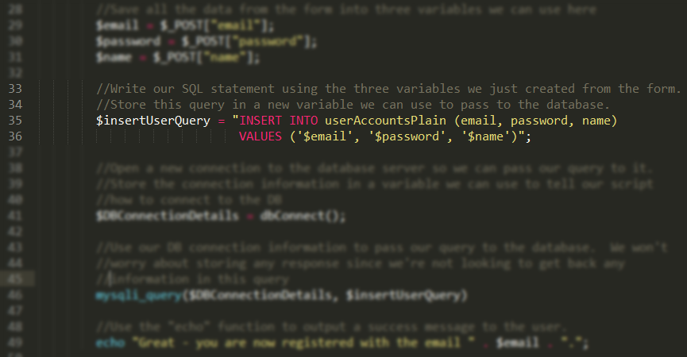
The code required to get data into the database
Script on target page loads the submitted data
Script prepares necessary SQL statements
Script connects to the DB and passes the SQL statement
DB processes the request and confirms results
Notes:
Talk about cloud?

Slide 12
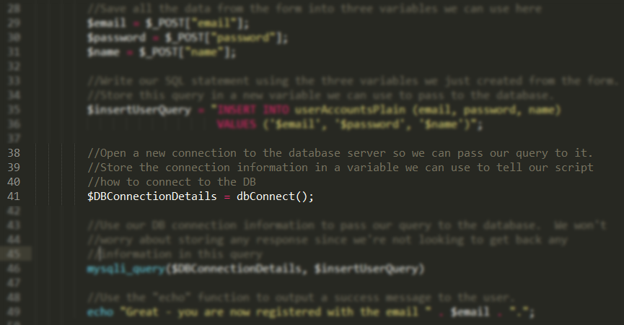
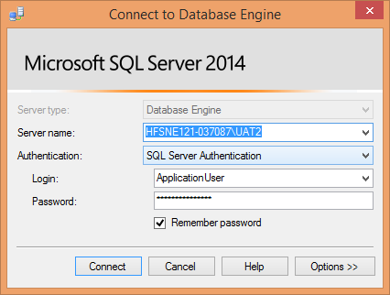
The code required to get data into the database
Script on target page loads the submitted data
Script prepares necessary SQL statements
Script connects to the DB and passes the SQL statement
DB processes the request and confirms results
Notes:
Talk about cloud?

Slide 13

The code required to get data into the database
Script on target page loads the submitted data
Script prepares necessary SQL statements
Script connects to the DB and passes the SQL statement
DB processes the request and confirms results
Notes:
Talk about cloud?

Slide 14
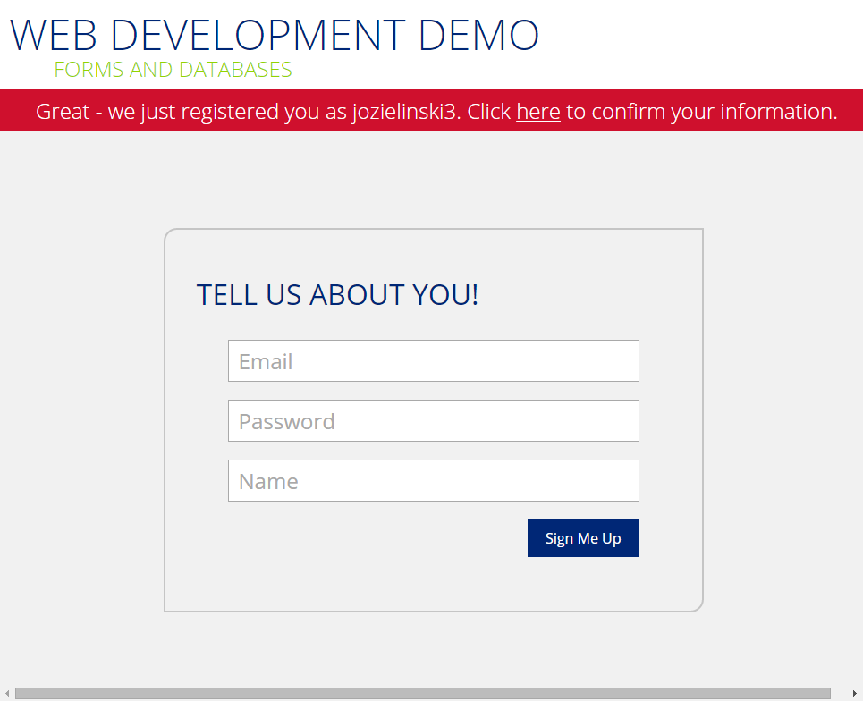
The code required to get data into the database
Notes:
Talk about cloud?

Slide 15
A conceptual flow chart of how we get the data out of the database
Client Side
Server Side
Data is collected through a form on an HTML page
Data is submitted to the target page
Script on target page loads the submitted data
Script prepares necessary SQL statements
Script connects to the database and passes the SQL statement
Database processes the request and confirms results
User sees the result page
Web server sends the parsed page back to browser
Script continues rendering the rest of the page
Notes:
Talk about cloud?

Slide 16
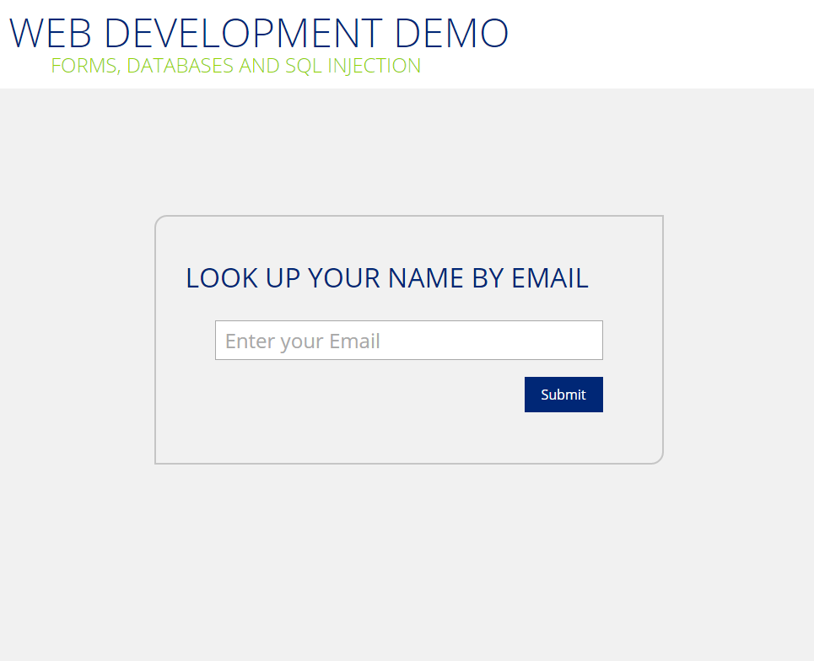
What our form looks like on the page

Slide 17
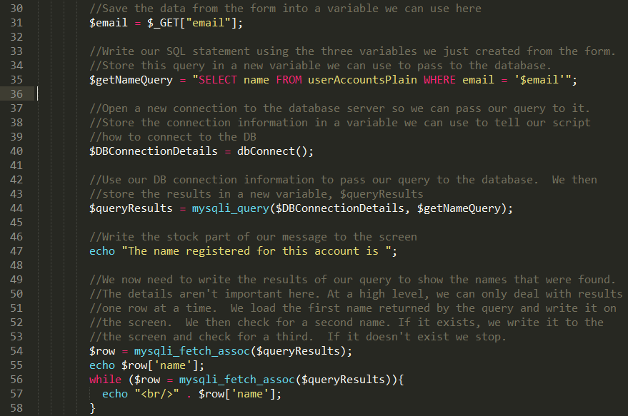

The code required to get data out of the database
Script on target page loads the submitted data
Script prepares necessary SQL statements
Script connects to the DB and passes the SQL statement
DB processes the request and returns results

Slide 18
Agenda – Practices, Principles, and Frameworks
Web Development Overview
Technologies
Interacting with a Database
Databases, Security and SQL Injection
Vendor Choices

Slide 19
The importance of data validation!
What are some of the dangers of not validating data before passing it to your database?
No value is entered when you expect one.
What if the user left their email blank? Does that work with the logic of your site?
The data types may not match.
What if you tried to store “Twenty Six” in a database column for age?
The lengths aren’t compatible.
What if your password field only takes 10 characters in the database, but your user enters one that is 15 characters long?
Special characters might cause issues with how your script translates user input into a query.
Did you try putting a single quote into the user lookup box?
Notes:
Talk about cloud?

Slide 20
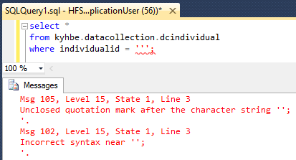
The problem with special characters
Notes:
Talk about cloud?

Slide 21
Overview of SQL injection
The code is putting whatever we enter into the query. How could we use this to change the query itself?
Try 1
What if we enter: jozielinski@Deloitte.com’ AND name =‘Bob
Try 2
What if we enter: whatever' OR 'one'='one

Slide 22
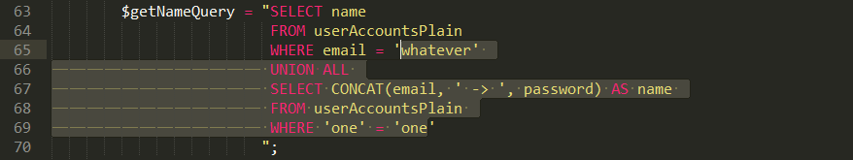
Overview of SQL injection
The code is putting whatever we enter into the query. How could we use this to change the query itself?
Try 3
What if we enter: whatever' UNION ALL SELECT CONCAT(email, ' -> ', password) AS name FROM userAccountsPlain WHERE 'one' = 'one
We just dumped all the emails and passwords from the DB! We are 1337 |-|4X0R5

Slide 23
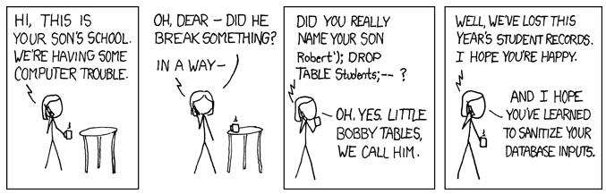
The best offence is a good defense
How do we defend against SQL injection attacks?
Use data validations. If you know users don’t need to use special characters, don’t even let the user enter them.
If you do need to allow special characters, use scripting techniques that specially encode these values so they don’t mess with your code. (This is similar to how the HTML page encoded special characters in our URLs).
Frameworks generally have all of the above built in from the start. They will give you special functions you can use that already takes care of this!
What can we do to especially protect sensitive data like passwords?
Use hashing to encrypt the passwords in the database. Even if they database is somehow hacked the values are each encrypted for a further level of security
Notes:
Talk about cloud?

Slide 24
60 second introduction to hashing
What is a cryptographic hash function?
It’s a function that maps a given input to exactly one output. These functions are known as “one-way” functions. This means that while it’s easy to go from input to output, it’s very difficult to go from output back to input.
The 1-1 nature of this is critical. Every time we encrypt “P@ssword” with our function we’re going to get back “382e0360e4eb7b70034fbaa69bec5786”. Additionally, no other input will give that output.
How do we use this to improve password security?
When storing passwords, we don’t store them in plain text. Instead we first run them through our hashing function and store the output
Example:
User enters “P@ssword” when signing up. We run it through our hashing function and get the output as “382e0360e4eb7b70034fbaa69bec5786”. We store this in the database.
Next time the user logs in, we get their email and password. We then run the password through our hashing function and get the output above. We search the DB for this combination of email and password. If we get a match we log them in. If not, we don’t!
How can you tell if a website isn’t hashing your passwords?
Password resets will tell you it all. Once a password is hashed, you can’t get the plaintext version back. If you use the Forgot Password feature of a website and it emails you your actual password, you know they’re not hashing it. This is why most sites force you to give a new password as a part of the Forgot Password process – they couldn’t give you the original even if they wanted!
Which major hotel chain was not hashing passwords until ~3 months ago?
Notes:
Talk about cloud?

Slide 25

60 second introduction to hashing
Notes:
Talk about cloud?

Slide 26
SQL Injection of a site with hashed passwords
What happens if we try to SQL inject the table with hashed passwords?
Try 3
What if we enter: whatever' UNION ALL SELECT CONCAT(email, ' -> ', password) AS name FROM userAccountsHashed WHERE 'one' = 'one
The hacker still gets the emails of all our users (which is not good), but at least in this scenario the passwords are all encrypted.
What weakness can you see with the one-to-one mapping from hashing?
(hint: would you ever expect to see duplicates in the hashed passwords from a large database of users?)
This is why it’s good to use passwords that are not English words, or their equivalents (e.g. P@s5w0rd)
Increased computer power means hackers can try 350B passwords a second. A 7 character password can be cracked in <30 secs. An 11 character password takes 25 years.

